Slide 1
compact groups
Gissel - Sebastián - Ciria

Slide 2
Total of 130 CG in the south
On the next slide you can see the S-PLUS’s footprint
Green square: are the fields that have already been observed in any data release.
Red square: are the fields that were not observed.
White square: fields that are no longer in the S-PLUS footprint
Magenta Circles: CG
Any other color is considered observed fields.

Slide 3
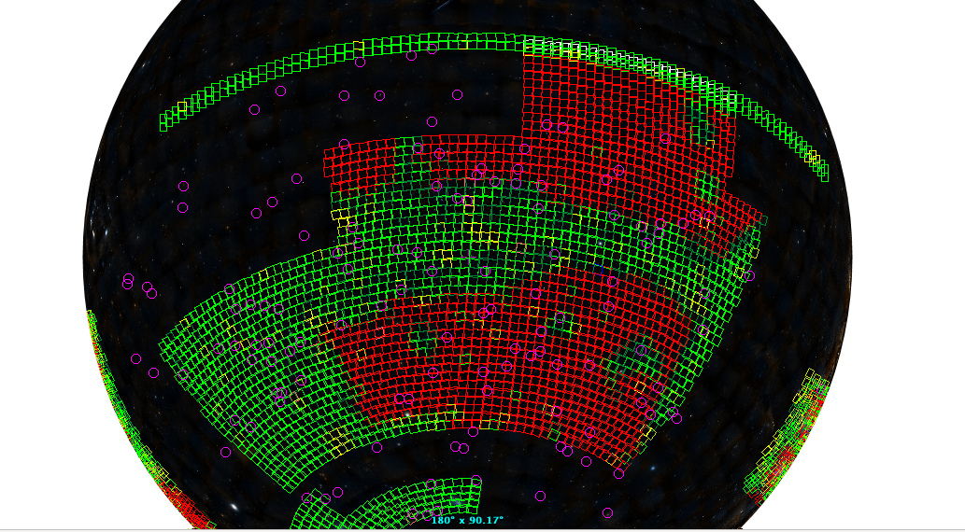

Slide 4
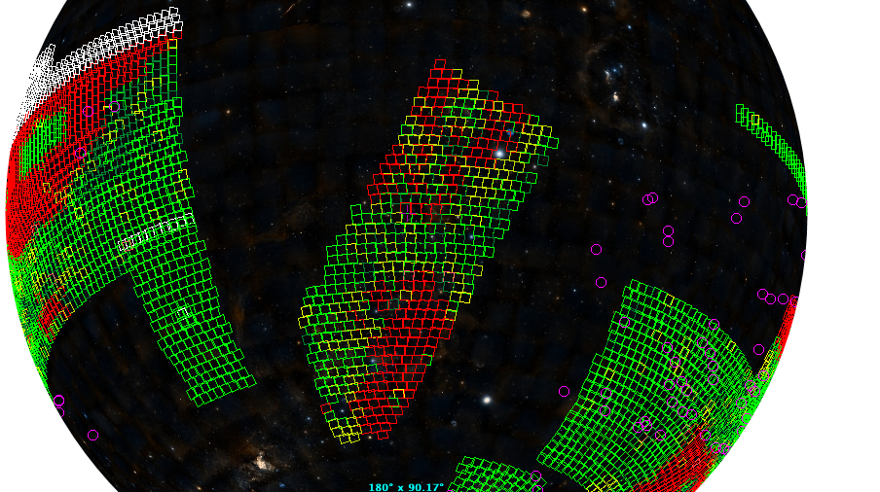

Slide 5
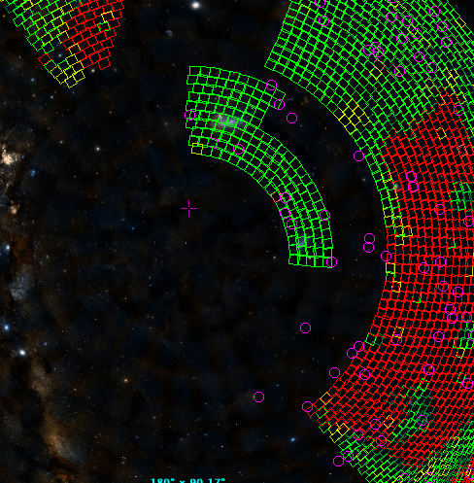

Slide 6
CG
There are some CG that was already observed (magenta circles on top of the green squares).
However, there are CG that are in the footprint but have not yet been observed (magenta circles on top of the red squares).
Additionally, there are CG in regions that don’t are covered by the S-PLUS (isolated magenta circles. )

Slide 7
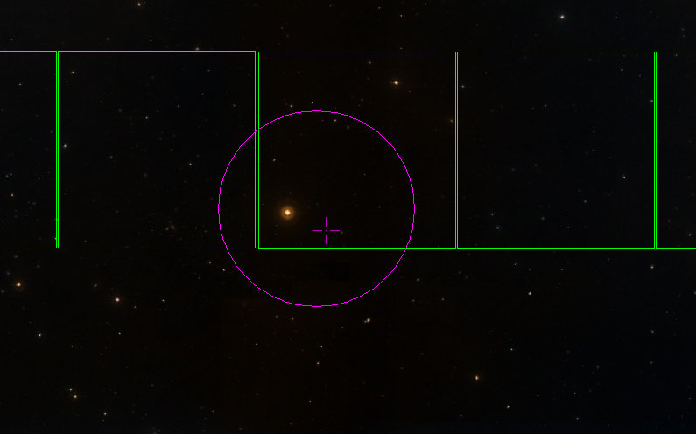
There are 7 CG that are close to the footprint but I don't know if the CG’s galaxies are within the observed area. Like the CG (called 20) in the figure below. Gissel or Sebas could look if the GC’s galaxies are inside the green square for these 7 CG that shows this behavior.
Link to the S-PLUS footprint S-PLUS filter (to create the squares in Aladin)
Link to the 7 CG in the edge of the footprint
Link to CG on top of the footprint that was observed(including the 7 in the footprint edge)

Slide 8
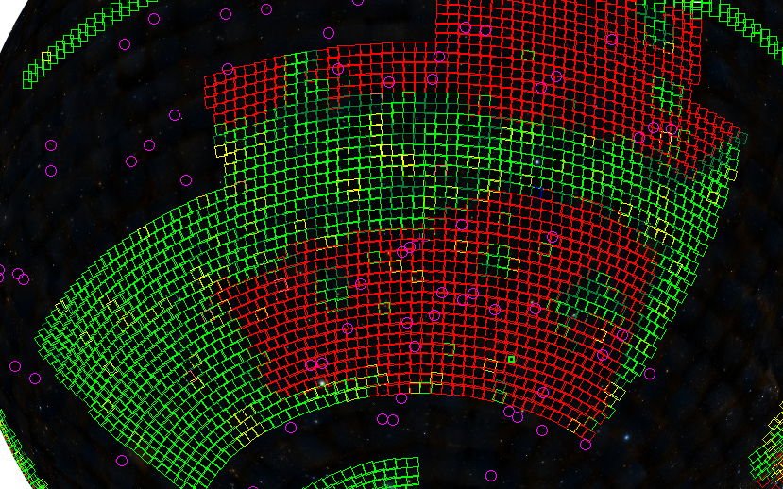
Link to CGs that are not in the footprint or that are in the footprint but haven't been observed yet (on top of the red square).

Slide 9
Now we have to find which CG should be prioritized to perform the observation

